Slide 1


Slide 2
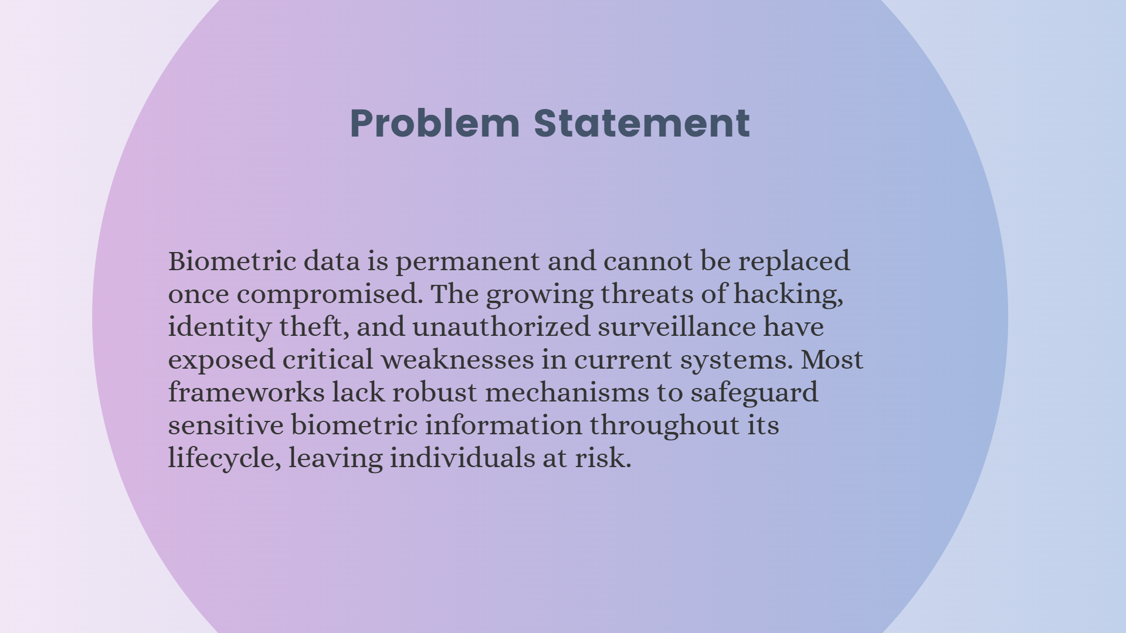

Slide 3
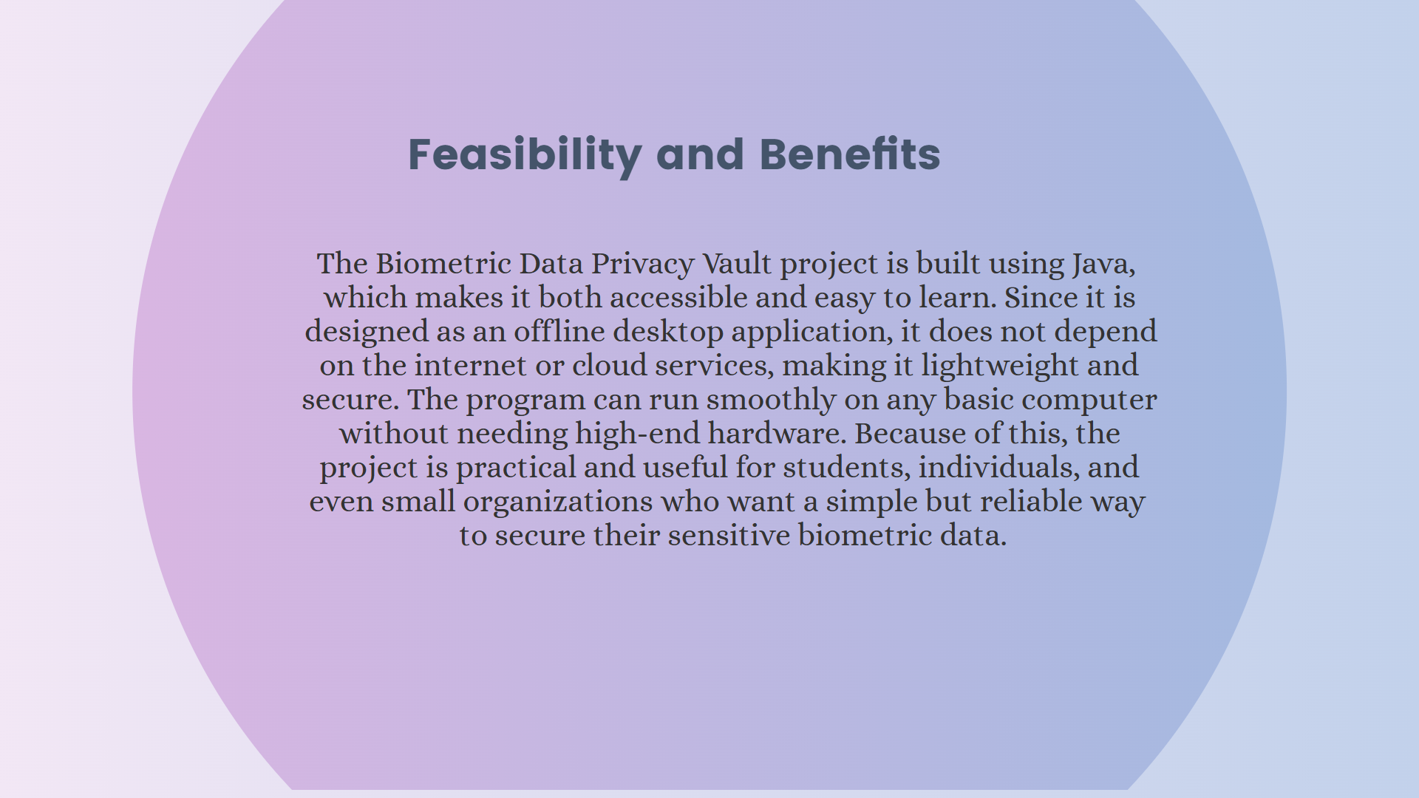

Slide 4
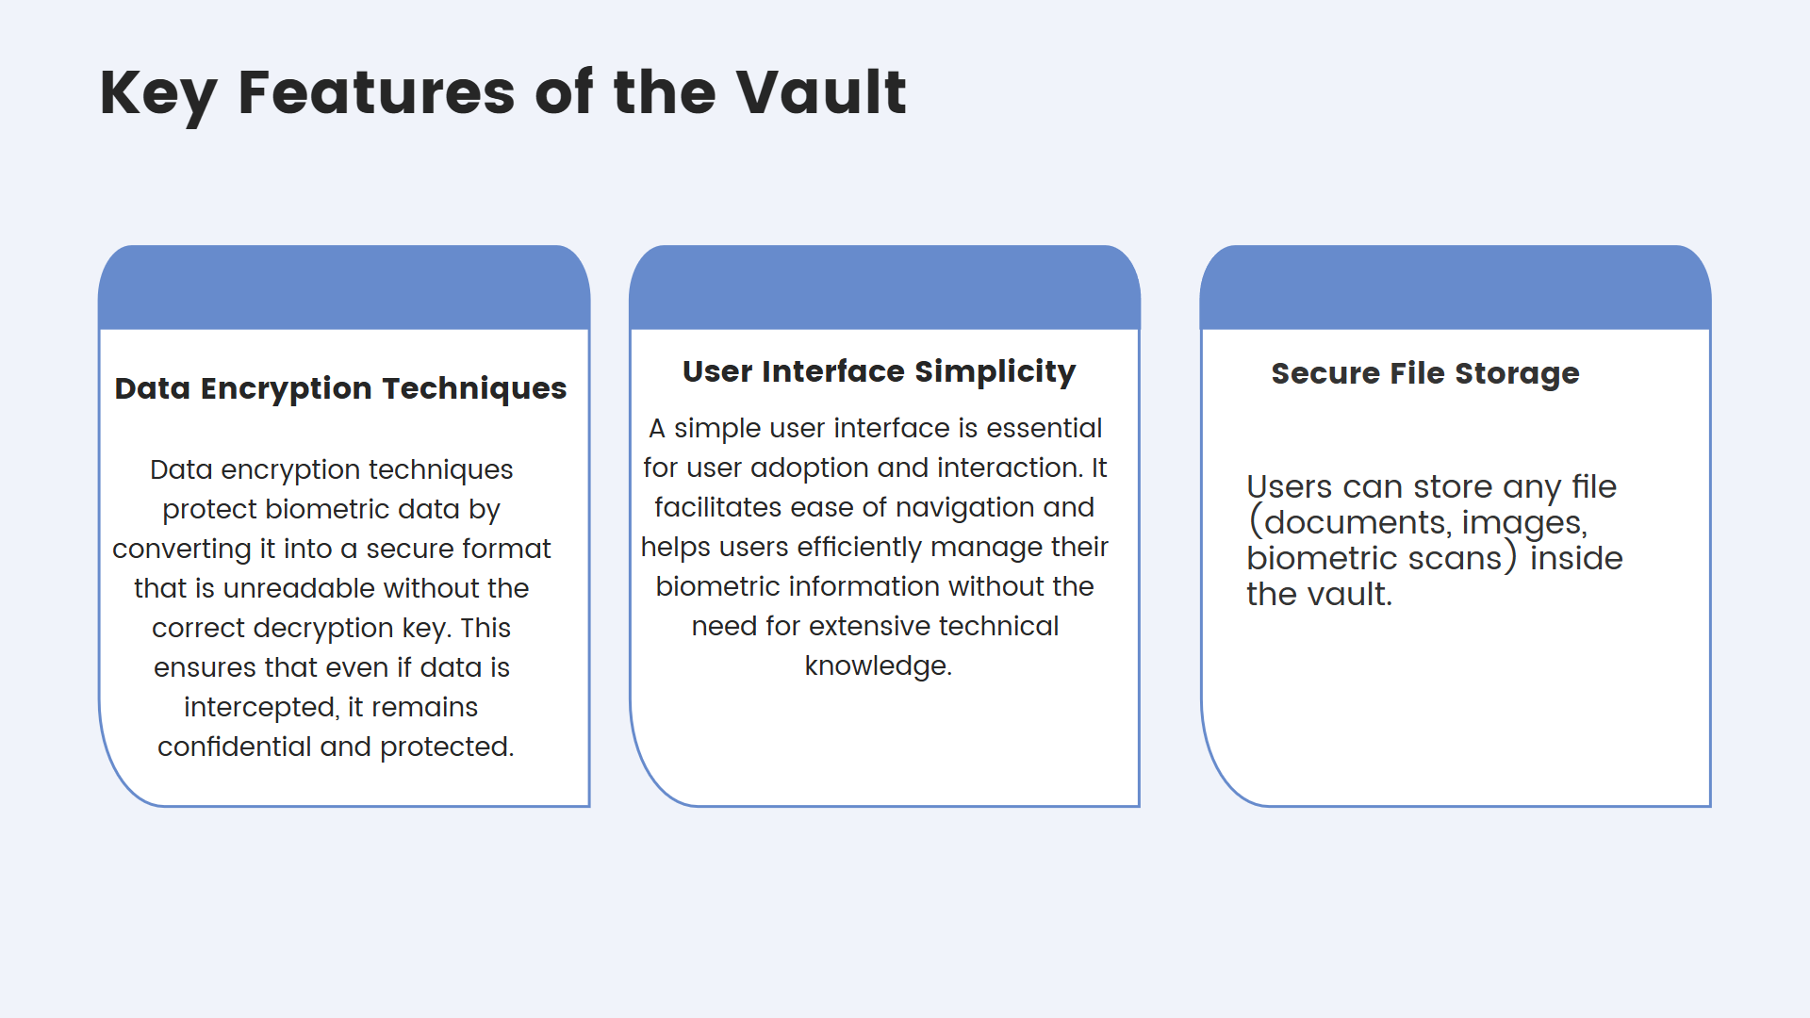

Slide 5
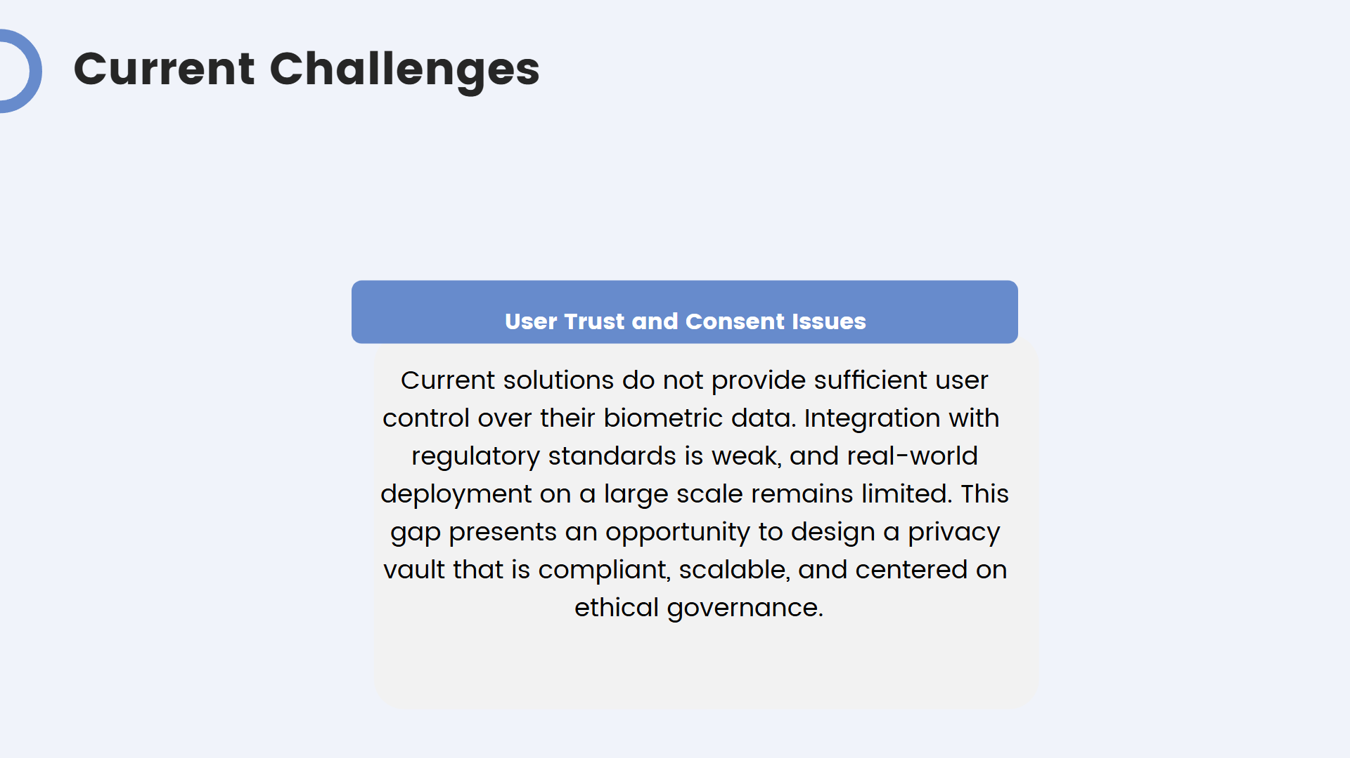

Slide 6
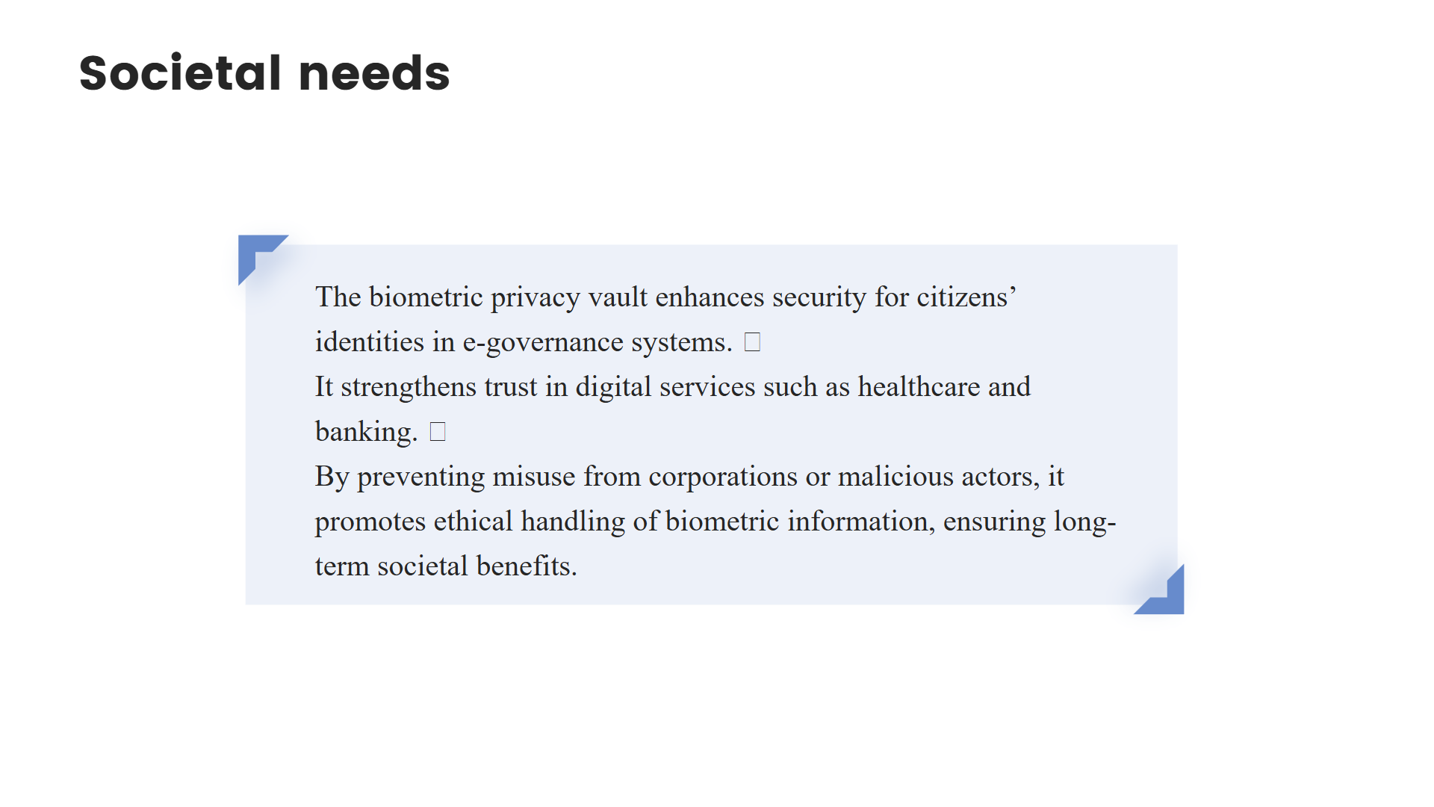

Slide 7
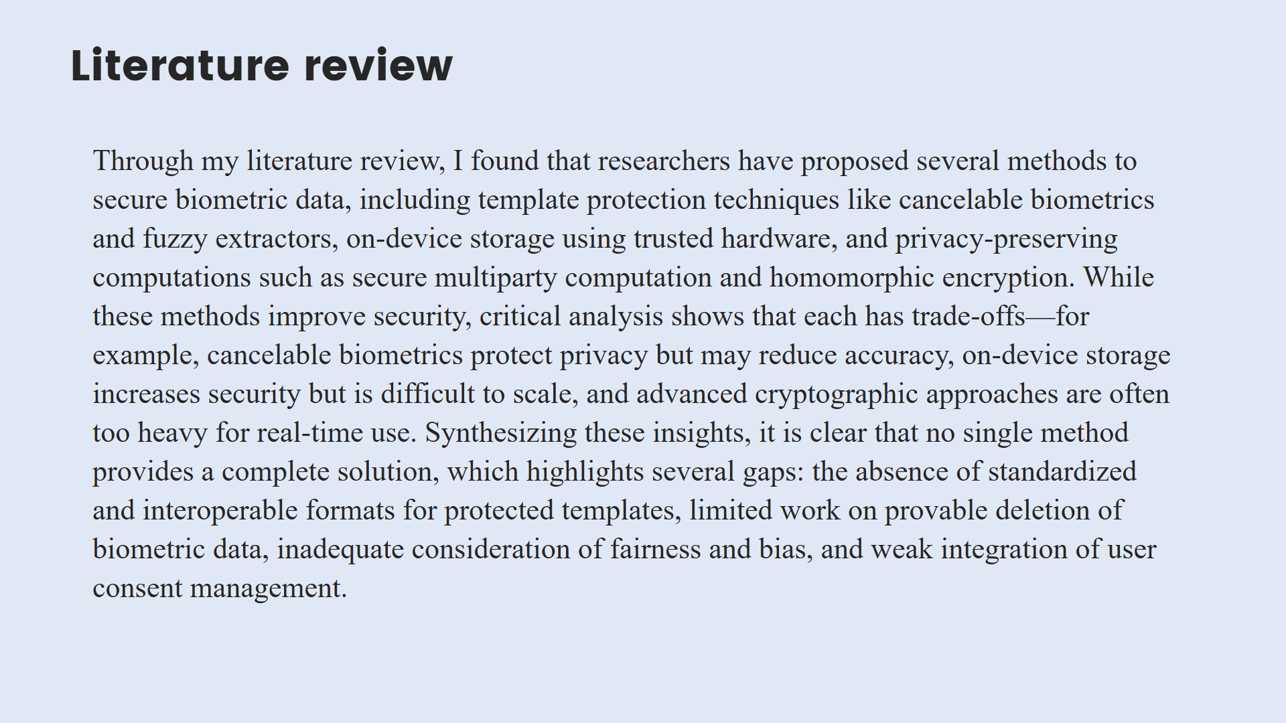

Slide 8

Conclusion
Biometric data is extremely sensitive and irreversible, making its protection a critical challenge. Existing approaches offer partial solutions but fail to fully ensure privacy, security, and user trust. The proposed Biometric Data Privacy Vault addresses this by combining strong encryption, template protection, secure storage, liveness detection, and consent management to provide a comprehensive framework. This vault not only safeguards biometric information but also ensures compliance with data protection regulations, making it a reliable and future-ready solution for secure digital identity management.

Slide 9

2410030076-KODALI NAGA SREEJA
2410030228–BIJJU ADITHI YADAV
2410030229-LIKITHA THUMMA
2410030232-H.ESHA MANOGNA
2410030430-MALREDDY MANOGNA

